Slide 1

Tech Stack evaluation - backend
INNOJC TECHNOLOGIES PVT LTD

Slide 2
Requirement of technologies
PROGRAMMING LANGUAGE
DATABASE
IDE
TESTING
BUILD TOOLS
LOGGING
SERVERS
FRAMEWORK

Slide 3
Programming language
Some common backend languages are Ruby, PHP, Java, Dot Net, and Python. These programming languages often run on frameworks that simplify the web development process.
RUBY
.NET
JAVA
PHP
PYTHON
For Backend Development Purposes we Selected Java.

Slide 4

Java is an object-oriented programming language. Which has many features like simple, Secure, platform Independent Etc.
Java language has tagged as Write Once Run Anywhere.
Java has 3 types of editions.
JAVA STANDARD EDITION - Desktop Applications.
JAVA ENTERPRISE EDITION – Web Applications.
JAVA MICRO EDITION – Mobile Applications.
Programming language - java
For Development Purposes we need Core Java and Advanced Java.

Slide 5
Integrated development environment
An Integrated Development Environment is a Software Application that helps programmers to develop software code efficiently. It Increases productivity by combining capabilities such as testing, building, and packaging in an easy-to-use application.
IntelliJ IDEA
Spring tool Suite
ECLIPSE
Visual Studio Code
IntelliJ and Eclipse are popular IDE’s for java development. IntelliJ is popular because of its feature code inspection.
Eclipse ide is popular among java developers because of its large community and plug-in support.
Eclipse is a cross-platform IDE whereas visual studio works only on windows as it is from Microsoft.
Eclipse is an open-source tool.

Slide 6
Build tools
Build Tools are Programs that automate the creation of executable applications from source code. Building means Compiling, Linking, and packaging the code into executable form.
GRADLE
ANT
MAVEN
Gradle is more powerful and has many features than maven, but for smaller projects we use maven because of its advantages.
Maven helps to manage all the process, such as building, documentation, releasing, and distribution in project management.
It simplifies the process of project building by pom.xml file.
Increases the performance of the project and building process.

Slide 7
Servers
The server is like a barrier that sends and retrieves the data from the database to the client.
WebLogic
JBoss
Tomcat
WebSphere
Jetty
There will be two types of servers Web Servers and Application Servers.
Web Server is used for which the data is of static type.
Application Server is for Which the data is Dynamic, Tomcat is one of the most important server Component.
For Java We use Tomcat, Jboss is also a popular Application server component.

Slide 8
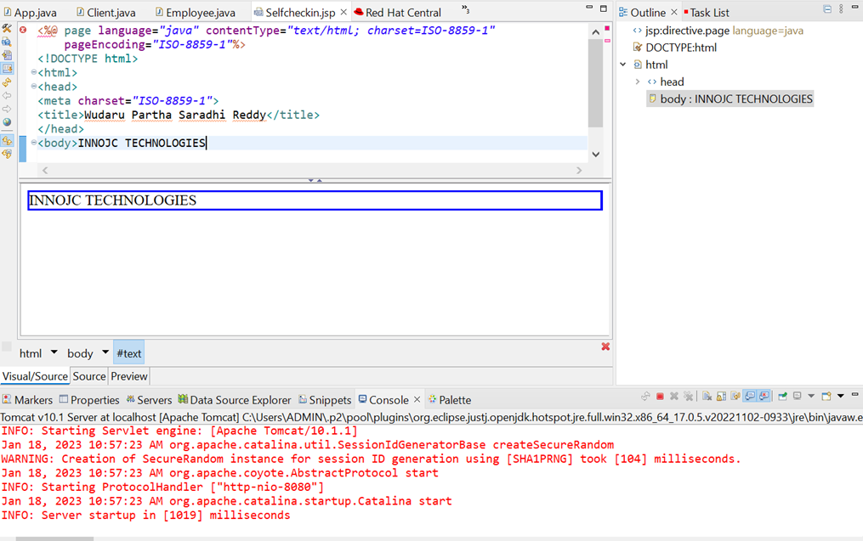
Working on Tomcat Server with eclipse ide

Slide 9
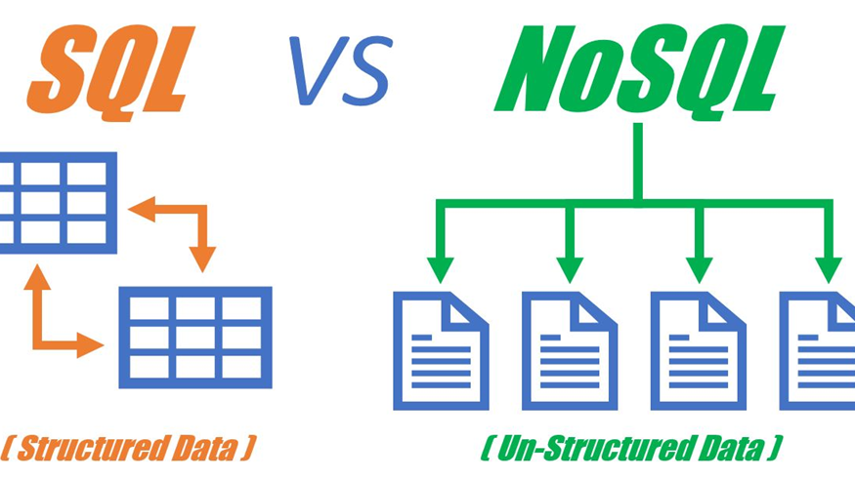
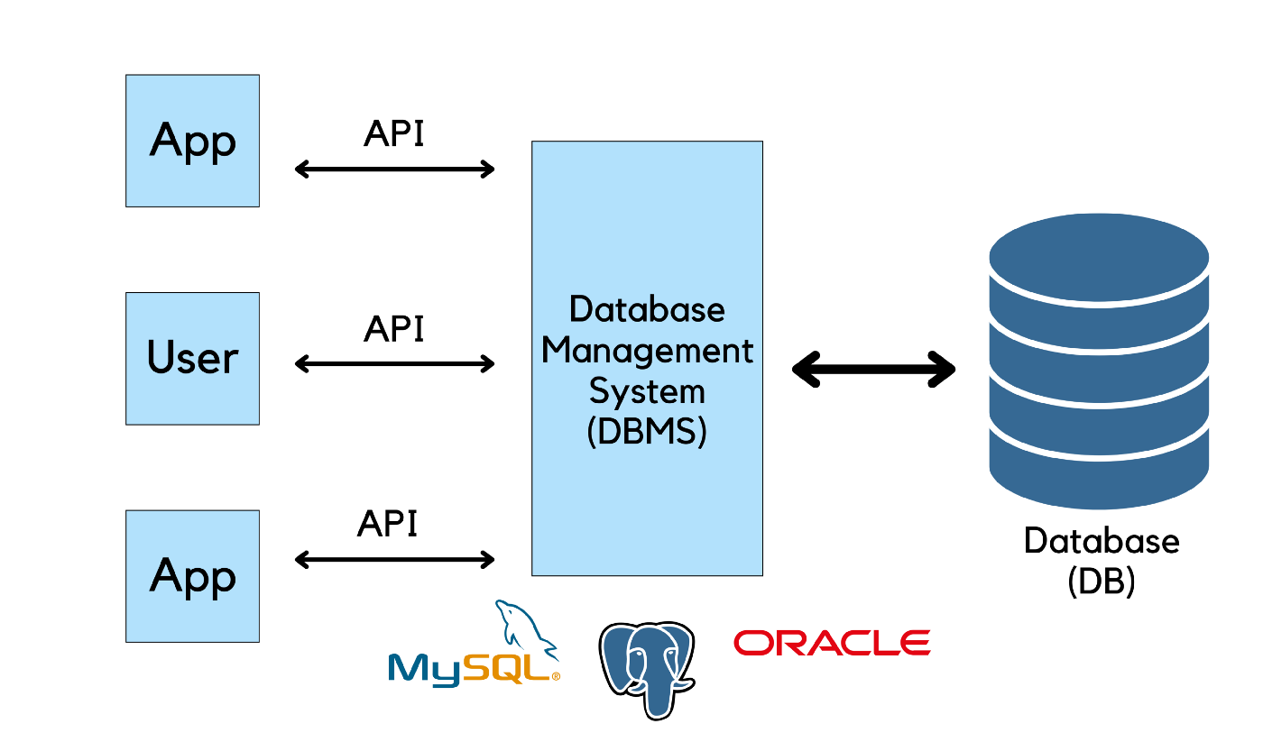
DAtabase
A Database is a collection of data, Information. It is managed by a database management system(DBMS).

Slide 10
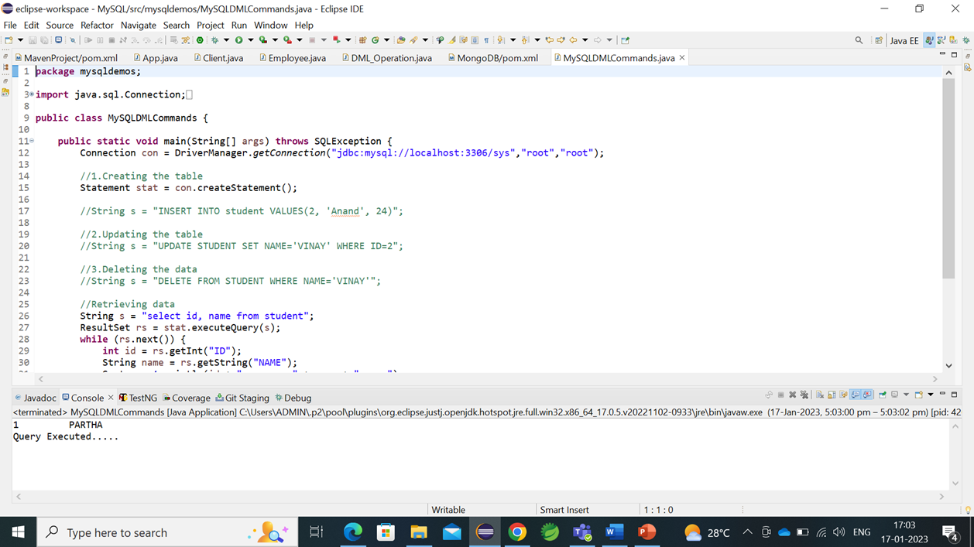
my SQL working with eclipse ide:

Slide 11

Logger:
Loggers are responsible for capturing events (called LogRecords) and passing them to the appropriate Appenders.
Appenders (also called Handlers in some logging frameworks) are responsible for recording log events to a destination.
Appenders use Layouts to format events before sending them to an output.

Slide 12
Need for Logging
It provides the complete tracing information of the application.
It records the critical failure if any occur in an application.

Slide 13
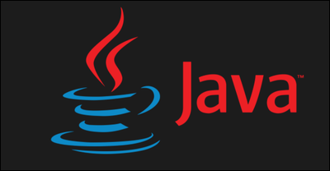
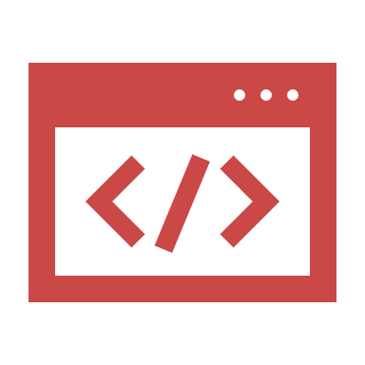
Logging Frameworks:
Log4j: Apache Log4j is an open-source Java-based logging utility.
SLF4J: It stands for Simple Logging Facade for Java (SLF4J). It is an abstraction layer for multiple logging frameworks such as Log4j, Logback, and java.util.logging.
Logback: It is an open-source project designed as a successor to Log4j version 1 before Log4j version 2 was released.
tinylog(tinylog): It is a light weighted and open-source logger.

Slide 14
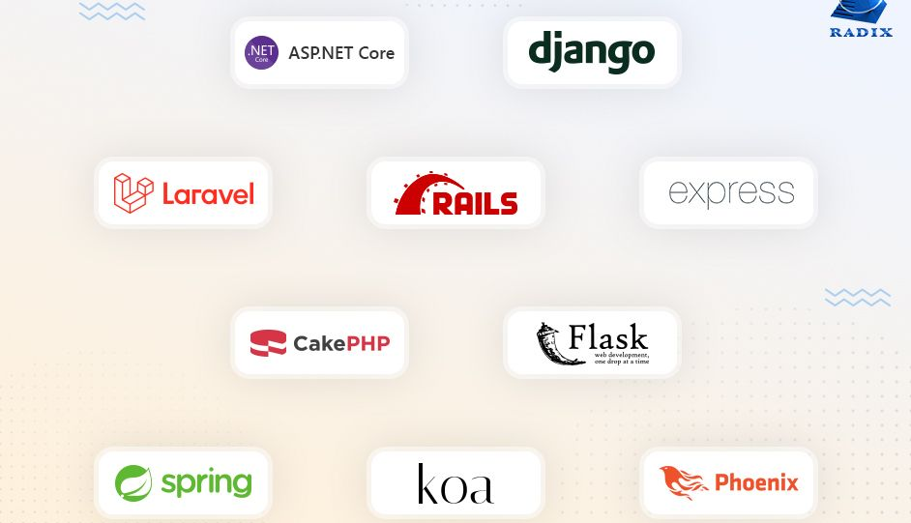
Different types of Backend Frameworks based on different programming languages:
Spring Framework + Spring boot for Java Developers
Django for Python Developers
Express.js for JavaScript Developers
ASP.NET core for .NET developers
Laravel for PHP Programmers
Ruby on Rails for Ruby Programmers
Flask Framework for Python Developers

Slide 15

Spring:
Spring is a framework used for java backend developers. It provides patterns and structure for java applications.
Spring helps developers to create high-performing applications using plain-old java objects
It provides infrastructure support for developing java applications.
And it is an open-source Backend framework.

Slide 16

Spring Boot:
Spring Boot is an extension of Spring, which eliminates the boilerplate configurations required for setting up a Spring application.
Featuring default codes and annotation-based configuration, Spring Boot enables a faster and more efficient development ecosystem.
Since Spring Boot is built on top of Spring, it offers all the features and benefits of Spring.
Spring Boot aims to reduce code length and provides developers with the easiest way to build an application.

Slide 17

CONCLUSION
After the completion of Sprint -1,
We choose Java as the Programming language, Spring as the framework and MySQL as Database with JDBC connectivity.

Slide 18

Thank you

